Slide 1



DEPARTMENT OF COMPUTER SCIENCE & ENGINEERING,
RAJARAMBAPU INSTITUTE OF TECHNOLOGY,
RAJARAMNAGAR.

Slide 2
Media Player via Image Processing
Mini Project Lab’s Presentation on

Slide 3
Contents
Introduction
Problem Statement, Objectives.
Features
Future functionalities.
Requirement Specification
Software, Hardware requirements.`
Design Phase
Use case, Data flow, E-R modelling, Block diagrams
Timeline
Expected time-period for completion.
Current Status
Which our team done until now ?

Slide 4

1
INTRODUCTION

Slide 5
Project Statement
design and develop media player inbounded with color recognizing functions via Image Processing.
To

Slide 6




Objective
We are preparing this project by drawing and visioning certain objectives as:
Design
Development
Function
Social
To analysis, design and develop real-time application.
To develop simple interactive media player.
To operate open, close, start, resume media files using color recognition functions
Also provide solution for people who disable to move.

Slide 7
1
Features

Slide 8
Features
Easy to use
Easy to handle for any unknown
Formats
Image Processing
Support many formats for audio as well as video.
Color cards will be recognize and detect by media player.
Functionality Support
Supports functionality like pause, resume, rewind also advanced functionality like Time sliders, Volume Slider etc
Attractive GUI
We are building attractive Graphical User Interface [GUI]
Open CV
Media Player has webcam to take frame. Open source computer vision library developed by Intel which help to handle webcam from system.

Slide 9

Functional Components
Module - I
Module - II
Module - III
Design and implementation of media player.
Capturing Image from webcam and detect it.
Color recognition of an Image and perform corresponding functions.

Slide 10
1
Requirement Specification
Notes:
KARTIK

Slide 11
Hardware:
Requirement Specification
Software:
Java Virtual Environment
Open CV 2.4.4 Framework
Java-Fx Libraries
Eclipse as Editor
Regular CPU Processor (At least Pentium)
RAM - least 2 GB.
Hard Drive - least 250 GB
Webcam support required..
Audio support required.

Slide 12
1
Designing
Phase

Slide 13
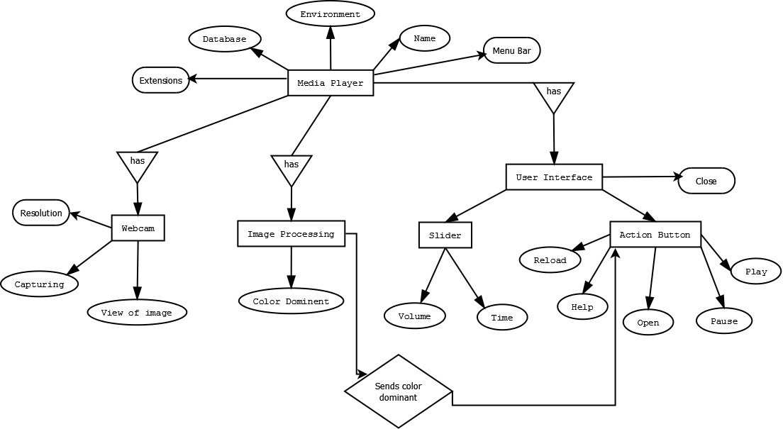
Notes:
KARTIK

Slide 14
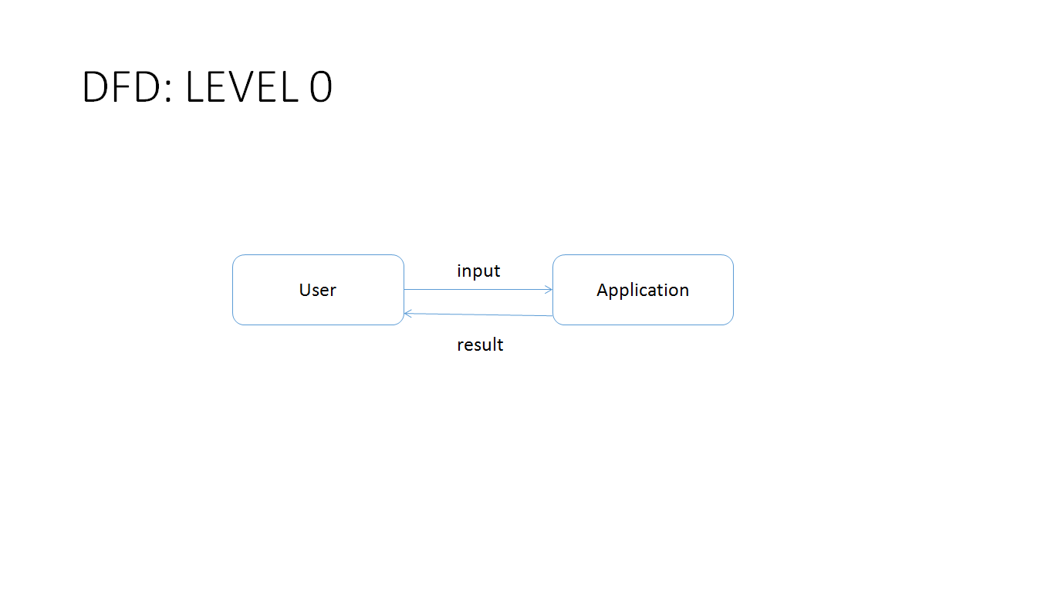
Notes:
AJAY

Slide 15
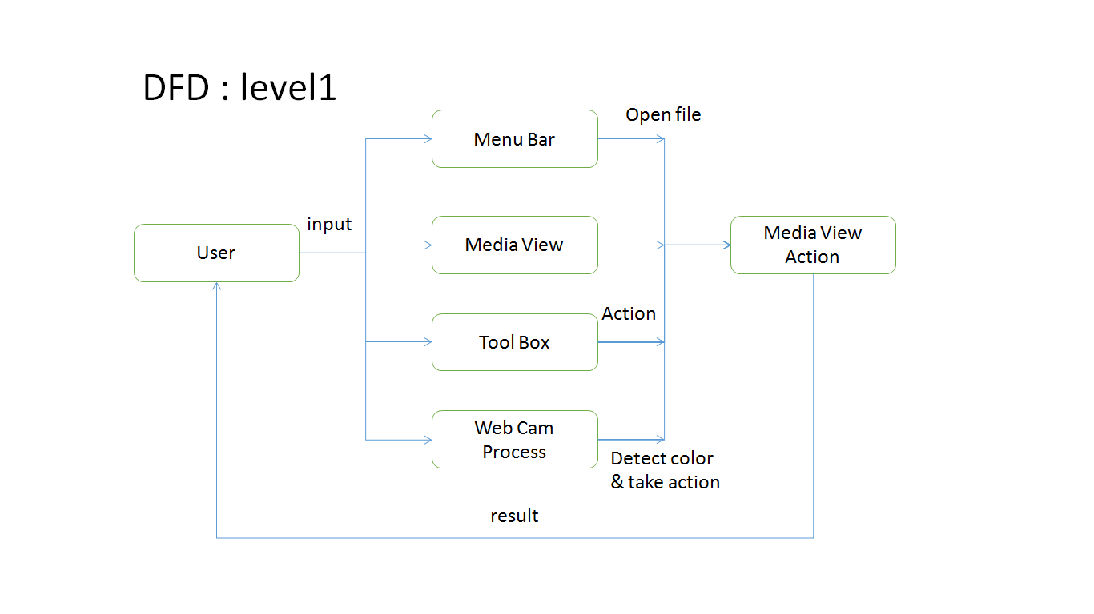
Designing Phase :
Notes:
AJAY

Slide 16
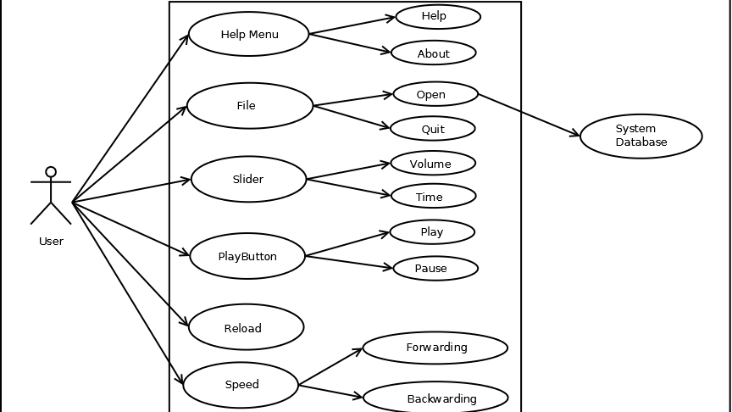
Design Phase : Use Case
Notes:
DUSHANT

Slide 17
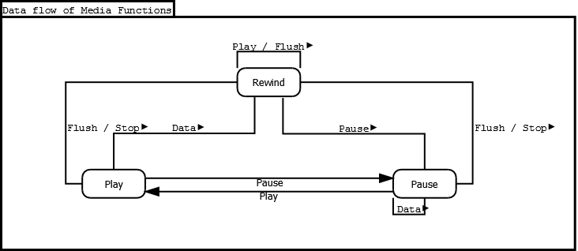
Designing Phase :
Data Flow for Media Function

Slide 18
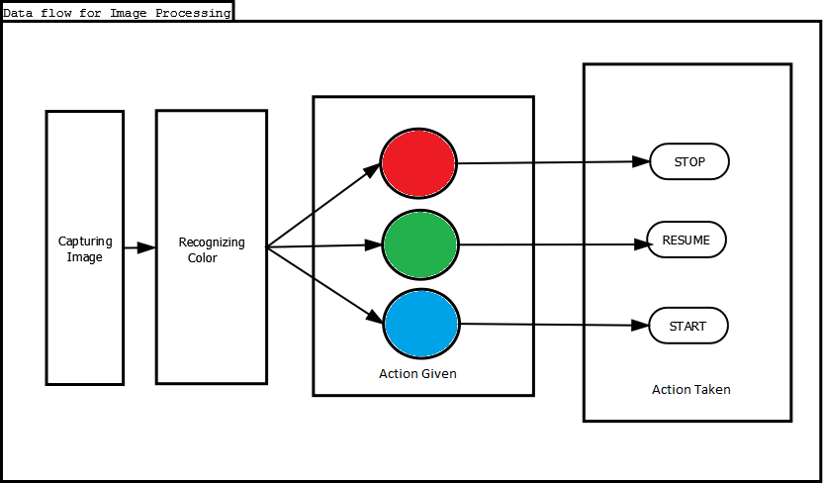
Designing Phase :
Data flow for image processing

Slide 19
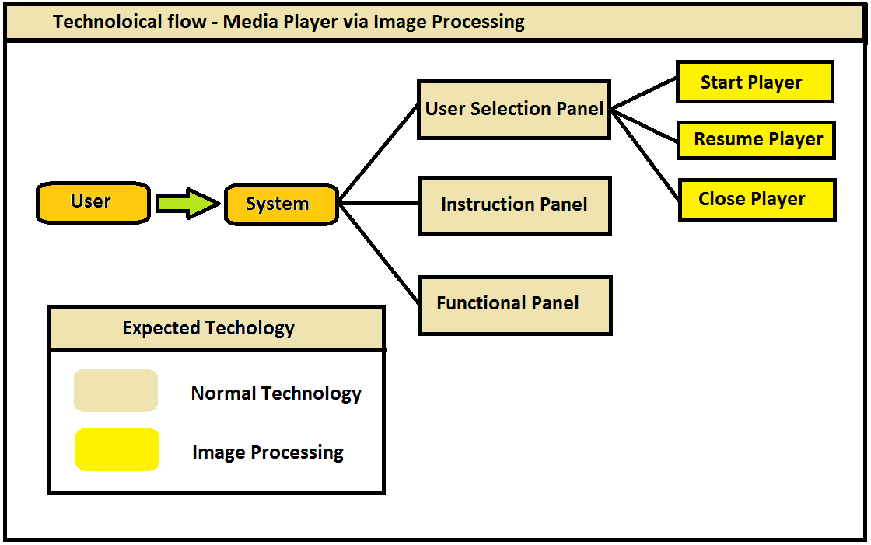
Designing Phase : Technology Flow

Slide 20
1
Coding
Phase
Notes:
YVT

Slide 21
Coding Phase: Current Work
Color Detection
Color Detection
File Insertion

Slide 22
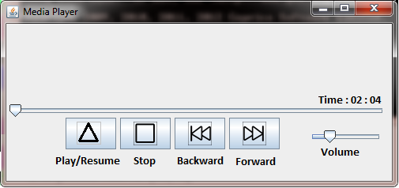

5
Prototype

Slide 23
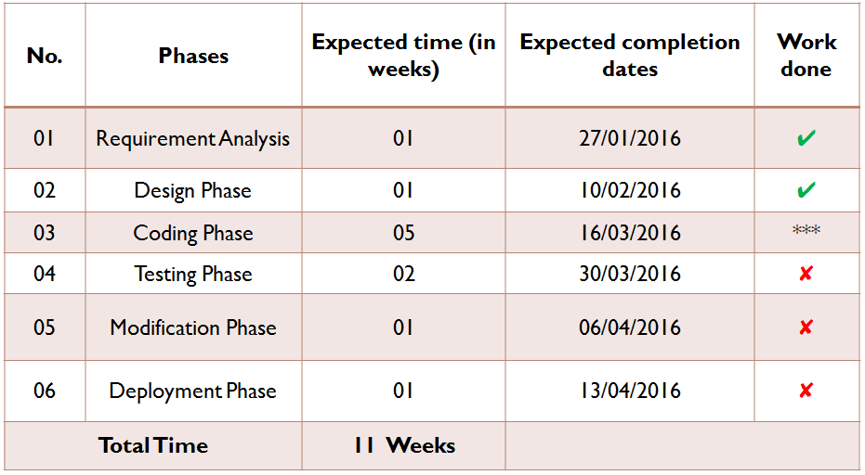
Timeline

Slide 24
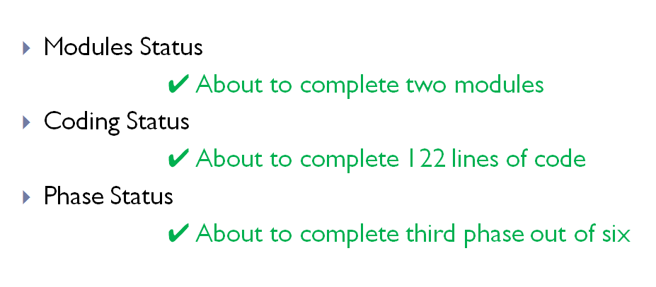
Current Status

Slide 25

Thank You !
Under Guidance of,
Prof. Mrs. Gautami G. Shingan
Presented by,
Yadnyawalkya Tale 1303052
Ajay Paratmandali 1303057
Kartik Patil 1303036
Dushant Gadekar
1303058

